Slide 1
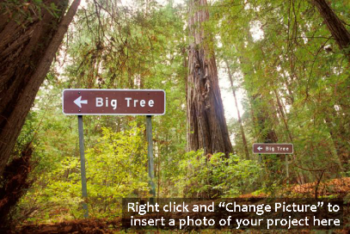
Project or Place Name
Project Place & Purpose
1-2 bullets describing key context (forest type, condition)
1-2 bullets touching on most important management goals
Keep font sizing at least 16 in all boxes!
Climate Change Impacts, Challenges, and Opportunities
Top 2-3 climate change-related issues affecting your project area
Audience: State your audience here
Notes:
This slide and the next are your homework!
Will be emailed to you, fill out and return to Maria no later than End-of-Business next week Tuesday (2/27)!!

Slide 2
Project or Place Name
Actions
Outcomes
Describe an adaptation tactic or set of related tactics that you are considering for implementation.
Describe the intended outcome from these actions
Describe another adaptation tactic or set of related tactics…
Describe the intended outcome from these actions
Describe another adaptation tactic or set of related tactics… or delete this box for space if the others are long.
Describe the intended outcome from these actions
Notes:
This slide and the next are your homework!
Will be emailed to you, fill out and return to Maria no later than End-of-Business next week Tuesday (2/27)!!

Slide 3
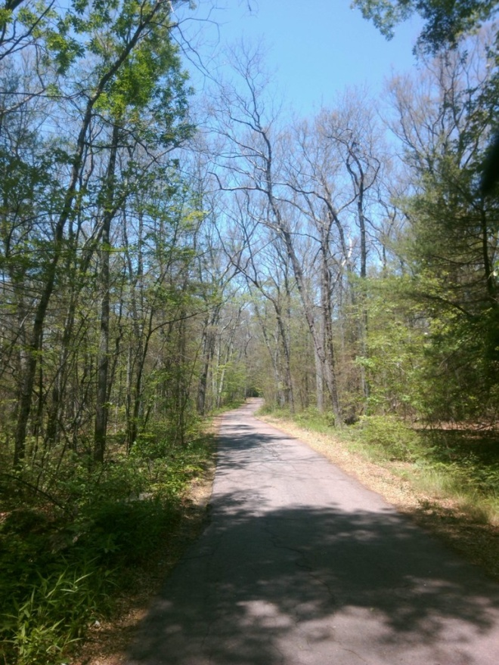
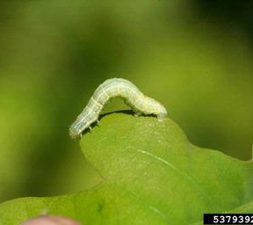
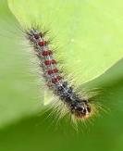
Example: Bristol Lot (Eastern Mass)
Project Place & Purpose
Former agricultural land
Increase the structural diversity of a mixed oak stand
Sustain the regeneration of oak species through the use of prescribed fire.
June 2016
Climate Change Impacts, Challenges, and Opportunities
impacts by insect pests could become more problematic in central hardwood-pine forests under a warmer climate(-).
Increased evapotranspiration and decreased soil moisture are likely to exacerbate summertime drying and contribute to drought-induced plant stress and decreases in productivity and survival(-).
central hardwood-pine forests are projected to have similar or increased habitat, including black, chestnut, scarlet, and white oak and pignut and shagbark hickory(+).
Audience: General public (Demo page at: www.forestadaptation.org/Bristol)

Slide 4
Example: Bristol Lot
Actions
Outcomes
Perform a silvicultural operation to remove crowded, damaged, or stressed trees in order to reduce competition for light, nutrients, and water. Create a mix of species, age classes, and stand structures to reduce the availability of host species for pests and pathogens.
High levels of diversity helps increase the ability of the stand to adapt to climate change.
Gives residual trees more nutrients and light to increase its viability to withstand drought stress and damage for pests and disease.
Use prescribed fire to maintain oak regeneration and sustain a mixed oak ecosystem.
Expand our Rx burn program and demonstrate how prescribed fire can be a useful tool in ecosystem management.
Plant blight resistant American chestnut if impact from insect pests is severe.
Reestablish American chestnut back into the Central Hardwood forest.

