Slide 1
Forest Adaptation Planning and Practices ~ Online Course ~
Session 6: Telling Your Adaptation Story: Part 1
Tuesday February 26, 2019
Discussion session: Please feel free to join the discussion on webcam or by phone – we want to hear from you!
Notes:
Welcome! We’ll get started in a few minutes. While everyone is getting settled, be sure you:

Slide 2
Check-in Using the Chat Box!
Type your name(s), organization

Slide 3
Today’s Agenda
Discussion:
Step 4&5 review
Monitoring discussion
Lecture:
Talking about climate change
Telling Your Adaptation Story
Homework for next time

Slide 4
Step 4 Check-in
How’s it going?
What other questions do you have?

Slide 5
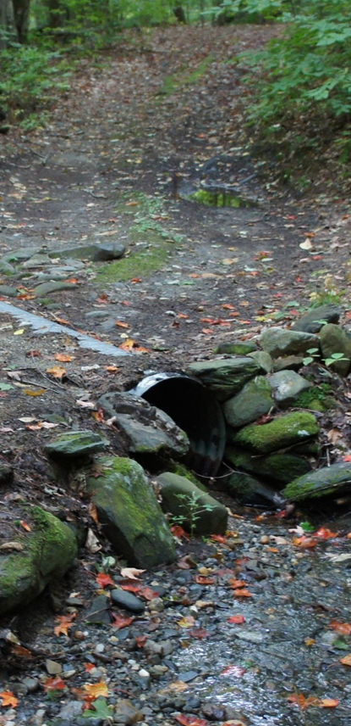
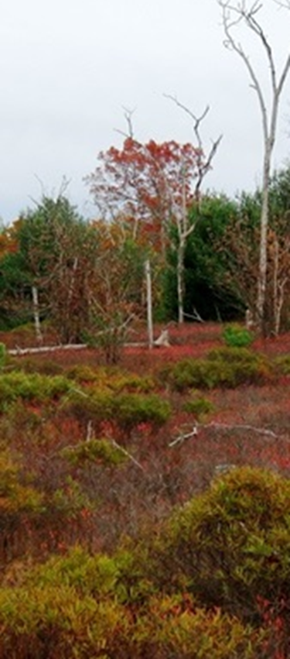
BRIEF RE-CAP
Step 5: MONITOR and evaluate effectiveness of implemented actions.

Slide 6
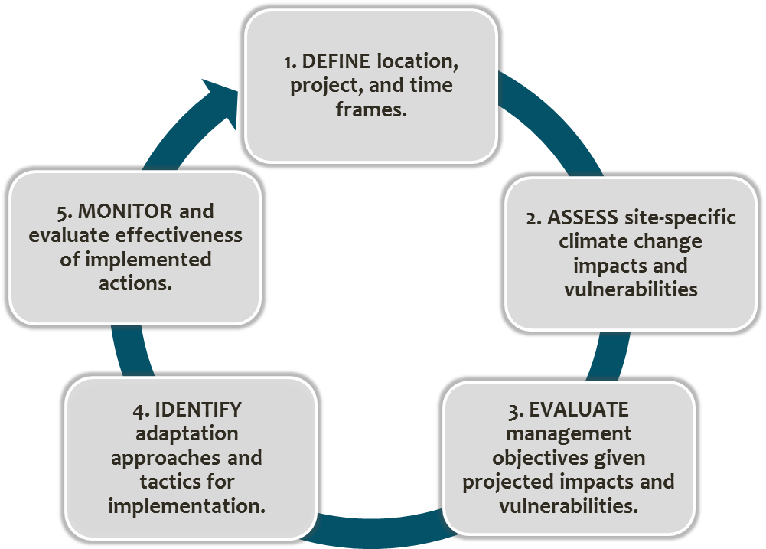
Adaptation Workbook Process
Notes:
Over the last few weeks we’ve met and used the Adaptation Workbook together. This thinking and thought process is basically just a guided discussion on climate change –
· what do you want to do - Step 1
· what risks/opportunities does CC present – Step 2
· do you still want to do that? - Step 3
· ok then how will you get there – Step 4
· and LASTLY (here, Step 5), what will you pay attention to?

Slide 7
Step 5: MONITOR and evaluate effectiveness of implemented actions.
How do we know if the selected actions were effective?
What can we learn from these actions to inform future management?
Notes:
Monitoring is critical for understanding what changes are occurring because of climate change as well as whether selected actions were effective in meeting mgmt goals and adapting forests to changing conditions.
This step helps to identify metrics that will be used to monitor whether management goals are achieved in the future and to determine whether the recommended management tactics were effective

Slide 8
Step 5: MONITOR and evaluate effectiveness of implemented actions.
Adaptation Monitoring Variable – What you will measure
Items that can tell you whether you have achieved your management goals & objectives.
If possible, use an item that also helps evaluate a particular tactic.
For example:
Planted seedling survival at 1, 2, 5, and 10 years after planting
Notes:
What you’re monitoring or measuring. In general terms, what do you think will be important to look at? And then, Specifically, what’s the variable (or indicator) you’re interested in using to evaluate whether you’re achieving your objective?
Is there nothing that will change, or does the focus change a bit? Seedlings success and growth are commonly monitored, but with climate change seedlings are expected to be the first to fail, so maybe they get an added emphasis.

Slide 9
Step 5: MONITOR and evaluate effectiveness of implemented actions.
Criteria for Evaluation – a value or threshold that is meaningful for assessing effectiveness or informing future decisions
What is success?
What you’re monitoring or measuring: What are the units on your data?
For example:
60% survival of non-local genotypes
Eradication of invasive species
Notes:
Criteria - What are the values/numbers you’re going to be looking for, i.e. what’s the bar you’ll set for whether your results are achieving the metric?
It is extremely complicated to try to tease exclusive effects of climate change and adaptation actions, so we don’t try to measure that. We measure how well we’re meeting our management goal. Maybe you decide to try something new, like allowing seedstock from another region to be planted at your site. You’ll want to measure the survival of those seedlings. Monitoring importance is the same, not different, because climate change has already been considered in the action.

Slide 10
Step 5: MONITOR and evaluate effectiveness of implemented actions.
Monitoring Implementation– How you will gather the information
How, and when the monitoring will actually get done.
Take advantage of existing monitoring when possible!
For example:
Regular post-planting stocking surveys.
Supplemental surveys at 10 years.
Annual fish surveys, # of fish, size
Notes:
How will you implement this monitoring - specifically, including time frames

Slide 11
What are you currently monitoring?
How does this relate to adaptation
actions and your goals and objectives?

Slide 12
Are there any new things you plan to start monitoring after completing step 5?

Slide 13
Are there things you’d like to monitor but don’t currently have the resources to do so?

Slide 14
What tools or resources are you aware of that could help you with monitoring?

Slide 15
Thoughts/Suggestions for Improving Step 5?

Slide 16
Homework

Slide 17
Landing Page

Slide 18
Export and Share Plan Instructions

Slide 19
Export and Share Plan

Slide 20
Save as PDF

Slide 21
Save

Slide 22
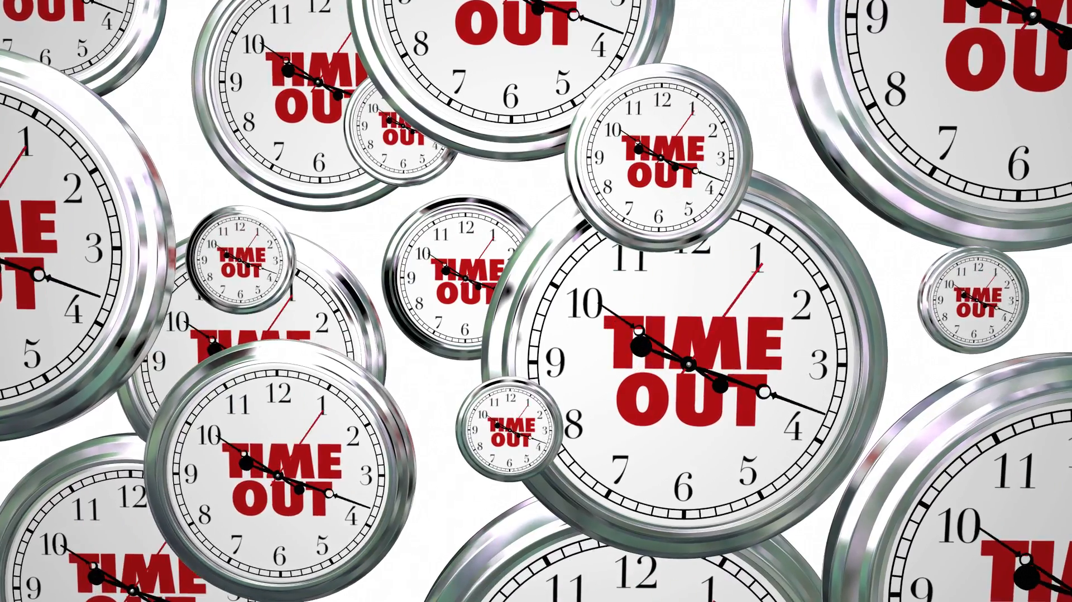

Slide 23
Today’s Agenda
Discussion:
Step 4&5 review
Monitoring discussion
Lecture:
Talking about climate change
Telling Your Adaptation Story
Homework for next time

Slide 24
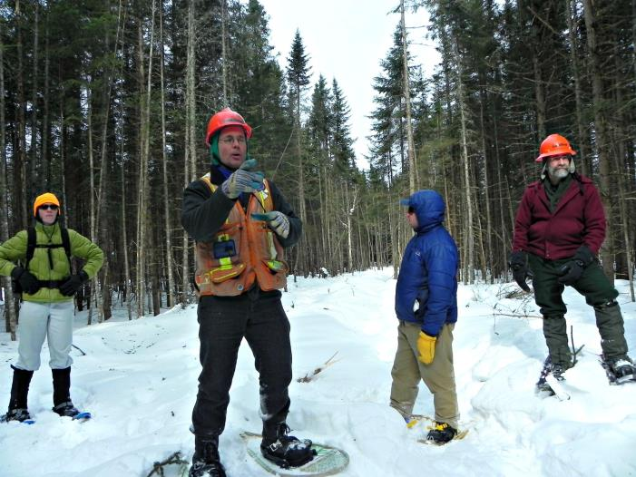
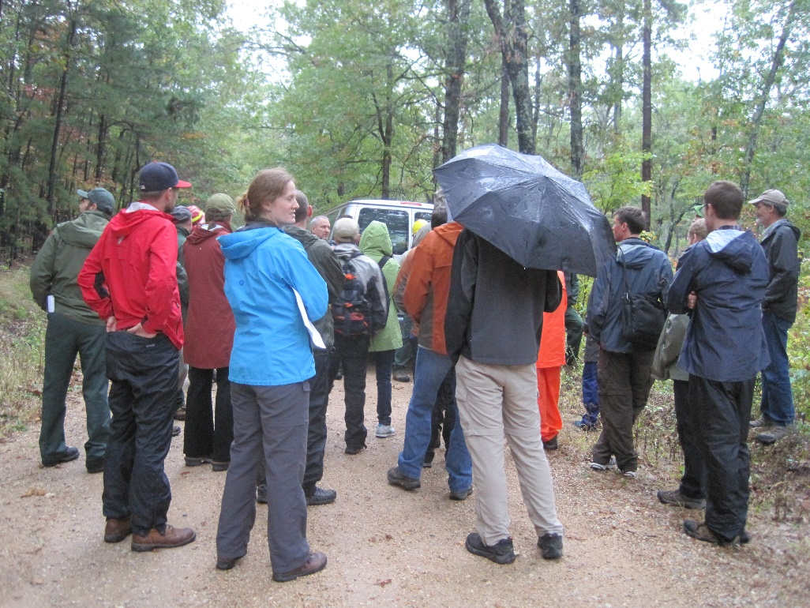
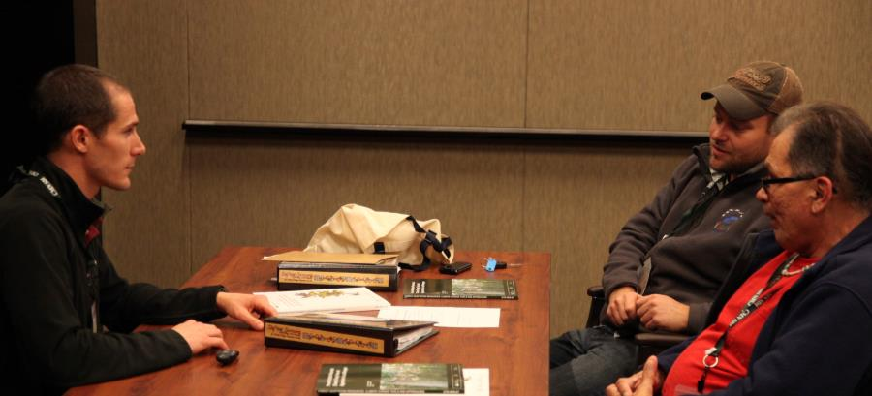
Talking about climate change
Notes:
Now that we’ve completed the adaptation planning process, the next step is to share it with your peers and stakeholders.

Slide 25
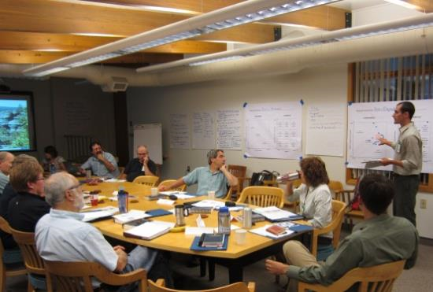
There is a need to understand and effectively communicate information about climate change to a diverse audience
Increasingly, forestry professionals are expected to integrate climate change into plans, documents, and activities.
Notes:
Client questions and concerns
Stakeholder-driven concerns on public lands
More prescriptive agency policies & guidance
Forest certification
Long-term economic forecasts

Slide 26
What experiences have you had regarding communicating about climate change with stakeholders?
Notes:
Aesthetics, recreation opportunities, food, future generations

Slide 27
What does your community think?
http://climatecommunication.yale.edu/visualizations-data/

Slide 28
Risk Perceptions: Marion Co., IN
http://climatecommunication.yale.edu/visualizations-data/ycom-us-2018/?est=happening&type=value&geo=county&id=18097

Slide 29
Reaching Your Audience

Slide 30
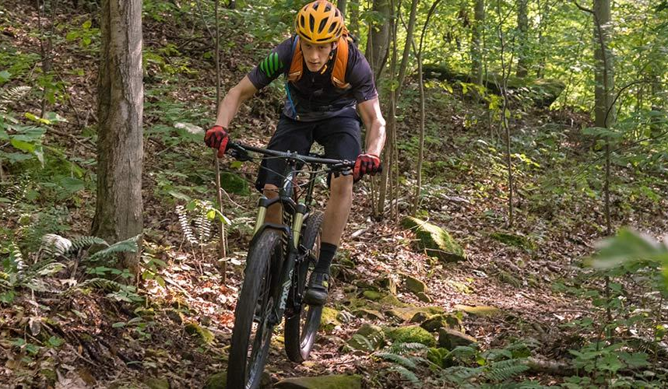
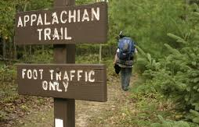
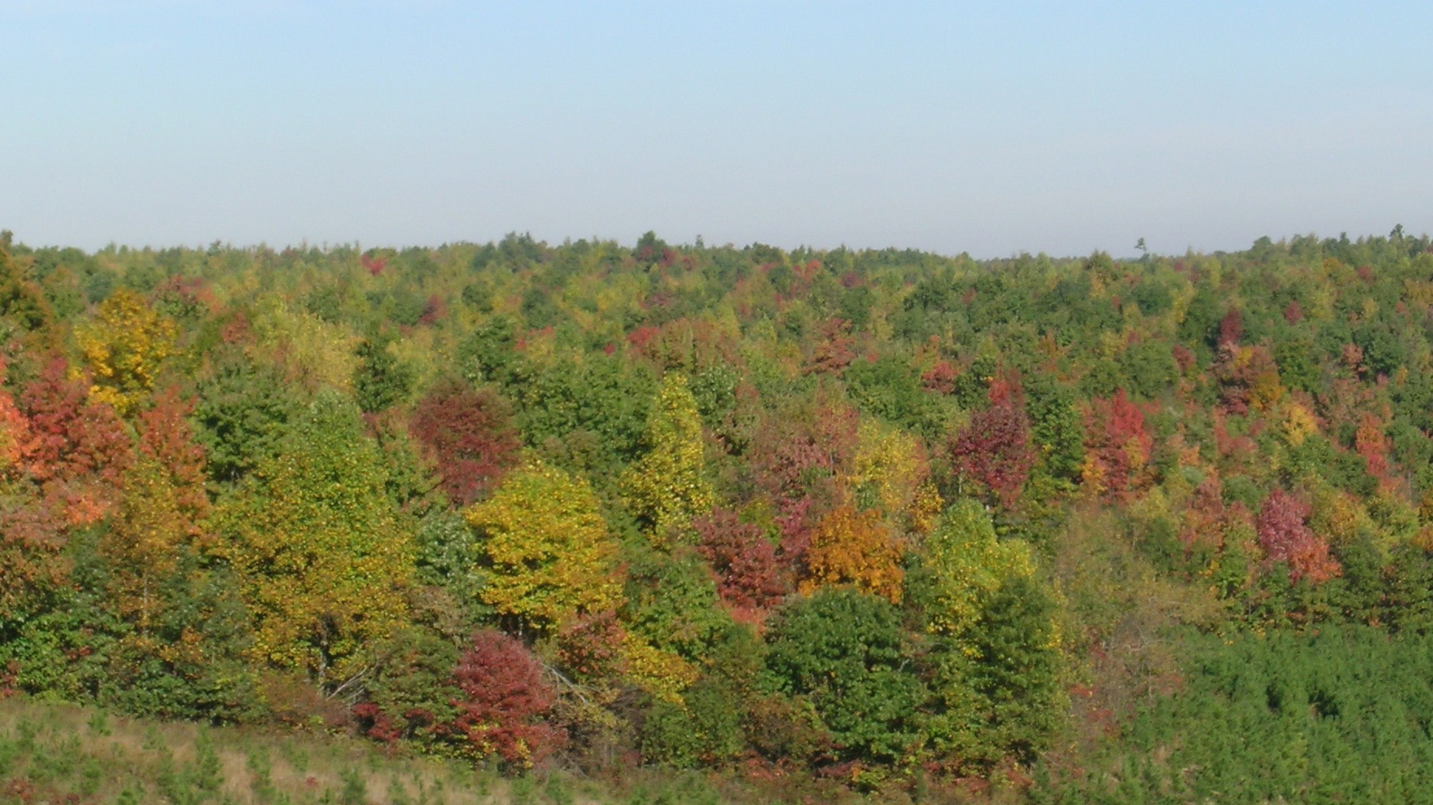
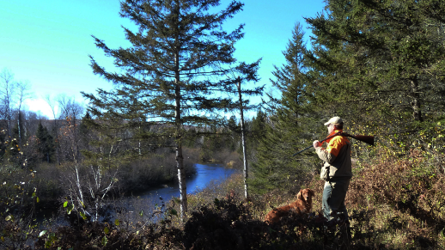
Connect with People’s Values

Slide 31
Focus on ‘self-transcending’ values
“Adapting to climate change will help us build a healthier forest that is more resilient to future changes ”
Vs.
“You will make money if we do a timber sale”

Slide 32
Connect with something your community cares about
Passionate about wildlife?
Talk about how climate change may affect local birds
Love winter sports?
Talk about how climate change may reduce opportunities for skiing
Think carefully about your audience
with each communication opportunity!

Slide 33
Use local disasters as a conversation starter
2019 Polar Vortex EVERYWHERE
2019 Rare December Tornadoes in Illinois
2018 Heat Wave in the Midwest (June)
2018 Hurricanes Florence and Michael
2016 Gatlinburg Fire
2014 Chicago Derecho
Focus on how coming together as a community helped overcome these challenges!
What can we do to make sure these impacts are less severe the next time around?
Notes:
Did you mention any of these impacts in step 2? If not, go back and add some of these ideas.

Slide 34
Focus on solutions rather than “Gloom and Doom”
“Intense precipitation events are increasing, so it make sense to invest in best management practices that will help reduce soil erosion”

Slide 35
Engage Across the Political Spectrum
These themes can resonate with a center-right audience:
Aesthetic beauty
Responsibility
Energy security
Jobs
Innovation
Tradition
Sense of place.
“The perfect past”
“This forest used to be a diverse oak-hickory forest that supported a wide variety of birds, and we should work to restore it.”

Slide 36
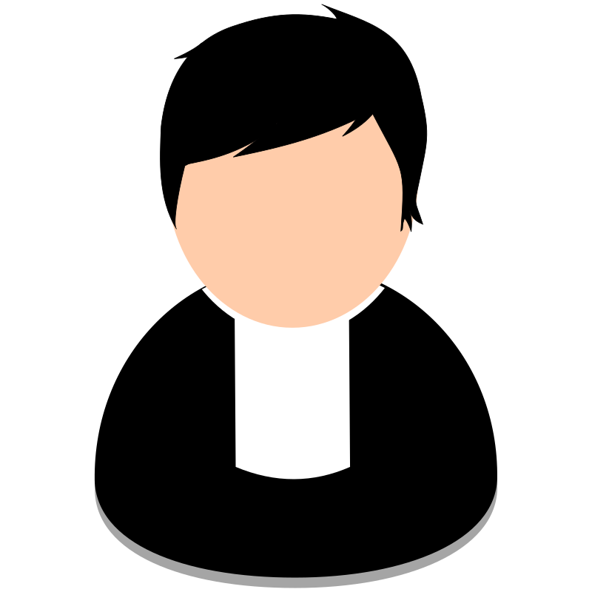
Use Trusted Messengers
Trusted peers
Faith networks
Outdoor recreation organizations
Scientists
Health professionals
NOT:
Politicians
The media

Slide 37
Climate change is vague – you should be specific
“We expect that within the next 20 years, we will see a 10-20% increase in 3-inch rain events, which could result in up to x% soil loss .”

Slide 38
List climate change impacts as some of many reasons
“Increasing species diversity in our forests will help reduce risks from future threats such as insect pests, disease, and warmer temperatures.”

Slide 39
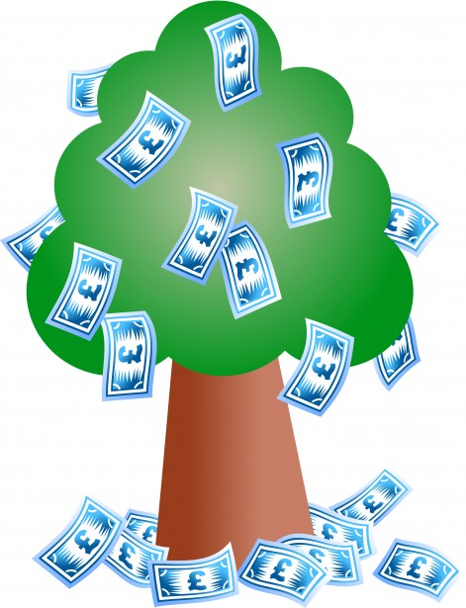
Telling Your Adaptation Story
Telling your adaptation story effectively can help you…
Gather support
Institutional
Financial
Reach a larger audience
Communicate key lessons
Notes:
… It’s common for FAPP participants to become discouraged while filling out Step 5 – because extra monitoring costs even more $$ than the new tactics will!
You probably started thinking about how in the heck to fund this while doing Step 5. Now is the time to think about how you will secure funding for these adaptation plans. And appeals for funding start with effective communication and Story-telling.

Slide 40
A Practical Example
Pre-proposal applications due April 5th!
www.wcsclimateadaptationfund.org

Slide 41
What makes a good story?
Get used to doing a few key things when you’re telling your adaptation story:
Tailor the message to the audience
Follow a logical sequence of ideas (connect the dots)
Be clear about intentionality
Include specific details
Connect your actions to the bigger picture
Notes:
Audience: Think about how the Adaptation Plan you describe might be communicated differently for a different audience – not the one that immediately comes to your mind. (If you immediately thought of a Board of Directors or your direct supervisor… what would it look like if/when communicated to the wider community? How about a Funding agency?)
Logical sequence (connecting the dots) and including specific details: include the level of detail necessary to get your point across, indicate that you thought it through, and back it up with sound logic/rationale; don’t overload with all the information in your plan
Bigger picture here = climate change, vulnerabilities, ecosystem management/conservation/adaptation

Slide 42
Example storyline
Place & purpose
Key risks from climate change
Adaptation actions to address key risks
Outcomes & Benefits
Feel familiar?
You’ve already done all of this thinking!

Slide 43
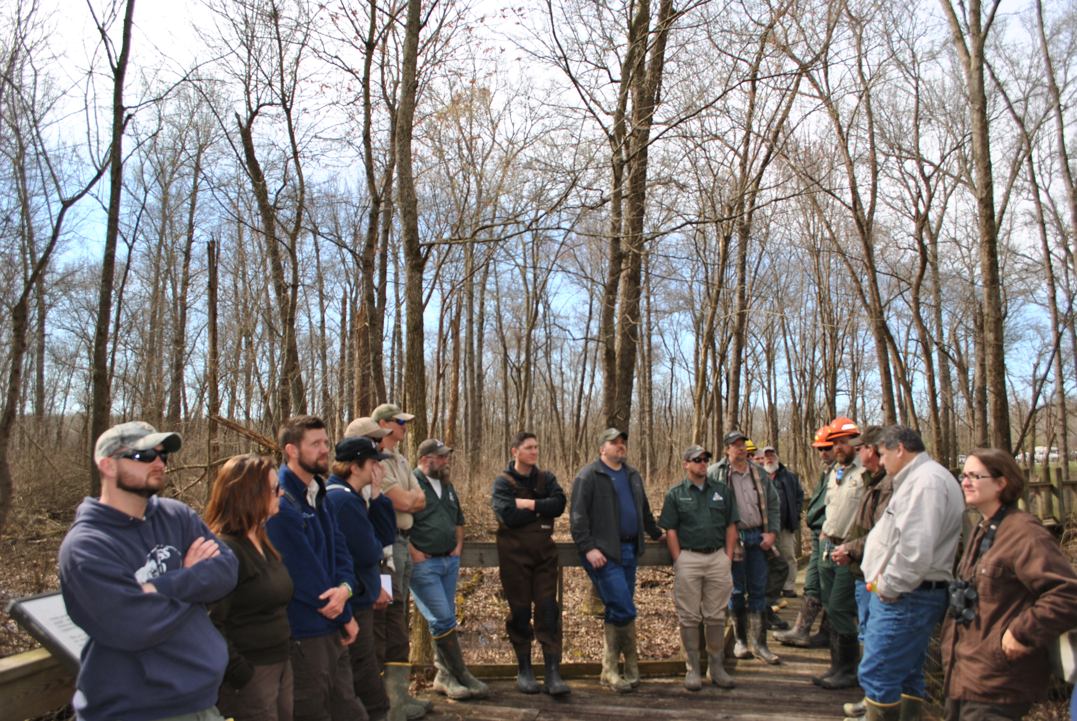
Bottomland Forest
Ducks Unlimited, the National Wild Turkey Federation and state and federal partners are using adaptation strategies to increase bottomland hardwood forest resilience to predicted changes in regional climate regimes in southern Illinois and Indiana.

Slide 44
https://www.youtube.com/watch?v=NAlNb7vxGo4&t=3s

Slide 45
What elements of the storyline did you see?
Place & purpose
Key risks from climate change
Adaptation actions to address key risks
Outcomes & Benefits

Slide 46
Example story: Bottomland Forest
Place & purpose
Key risks from climate change
Adaptation actions to address key risks
Outcomes & Benefits
Goals:
Restore/manage hydrologic conditions in wet bottomland forests and floodplain wetlands to increase their ability to withstand more severe and variable flood regimes
Enhance resilience and natural regeneration of flood-tolerant oak, hickory, and other hardwoods via thinning, prescribed burning and other silvicultural techniques
Restore wet bottomland forest stands, esp. at higher elevations & converted croplands, to reduce fragmentation and provide refugia for wet bottomland forest during future flooding.

Slide 47
Example story: Bottomland Forest
Place & purpose
Key risks from climate change
Adaptation actions to address key risks
Outcomes & Benefits
Impacts/challenges:
Heavy precipitation events are increasing in number and severity
Increase in total runoff and peak streamflow during the winter and spring could lead to increased magnitude of flooding, which may lead to changes in vegetative species composition
Habitat suitability for wet bottomland forest may be reduced at the lowest elevations in the landscape, and slightly higher elevations may serve as refugia for this habitat type

Slide 48
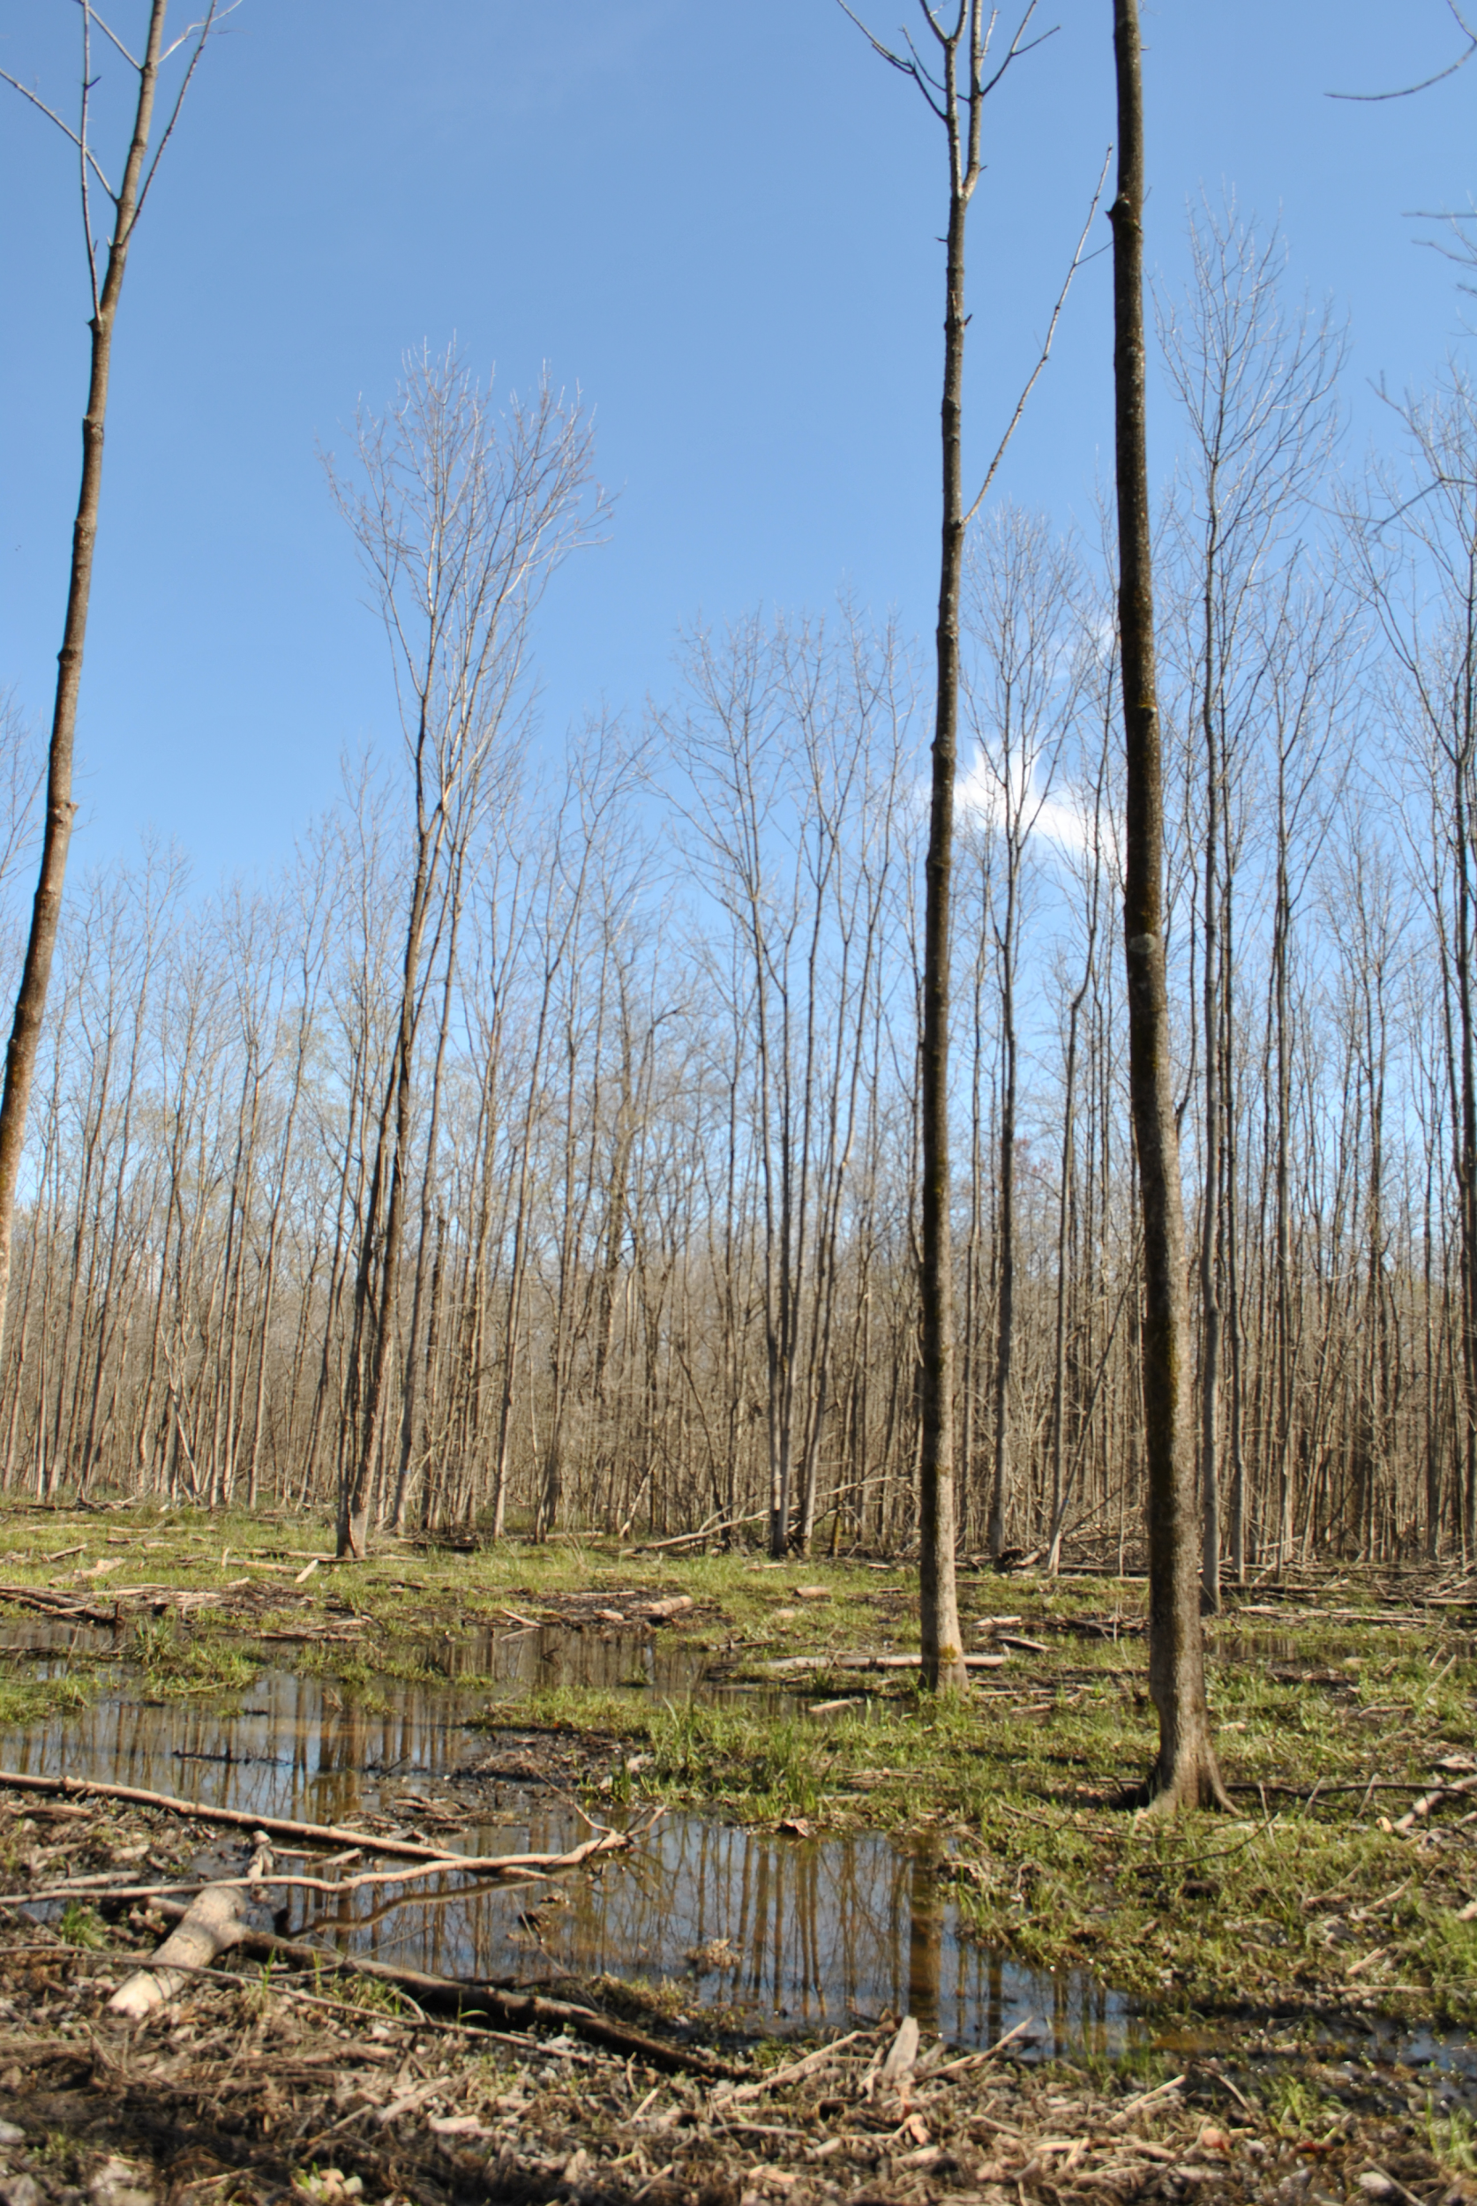
Example story: Bottomland Forest
Place & purpose
Key risks from climate change
Adaptation actions to address key risks
Outcomes & Benefits
Adaptation tactics:
Provide more productive wintering habitat for waterfowl not expected to migrate as far south, such as mallards, American black ducks, gadwalls, and wood ducks
Diversify the species composition and genetic stock of hardwood trees used for reforestation efforts, such as planting pin and willow oak seedlings from further south
Taking advantage of changes in hydrology to conduct controlled burns, tree stand improvements, and management for wetland diversity

Slide 49
Example story: Bottomland Forest
Place & purpose
Key risks from climate change
Adaptation actions to address key risks
Outcomes & Benefits
Outcomes and benefits:
The successful advancement of bottomland oaks above competing trees will serve as an indicator of success.
Waterfowl will continue to access good quality habitat
Bottomland oak vigor and regeneration will increase floral diversity and habitat resilience.
Species richness will be maintained or increase in the wetland sites.
Read more at https://tinyurl.com/bottomlands

Slide 50
Next week: Special Session!
You are the stars!
You will be given a 5 minute slot to share your story.
If you cannot attend the final class, send us your slides along with a recorded presentation
Be creative! What’s your future vision, and how will adaptation help you get there?

Slide 51
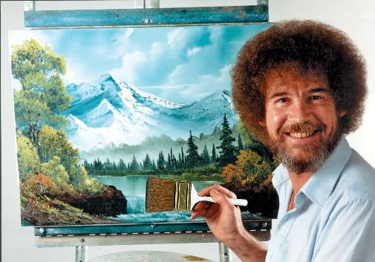
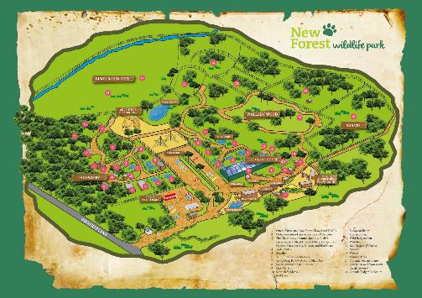
Poster Time!

Slide 52
Template Slide #1 (replace with your name location)
Audience: who’s your target?
Delete this box and insert a picture or map here
Project: Place & Purpose
Tell us the key info about your place!
Tell us the major management goals that relate to your story
Delete this box and insert a picture or map here
Notes:
This slide and the next are your homework!
Will be emailed to you, fill out and return to Molly no later than End-of-Business next week Wednesday (2/24) !

Slide 53
Template Slide #2: Climate Change Impacts, Challenges, Opportunities
Climate Change Impacts or Opportunities
- Tell us 2-4 impacts or opportunities that are most important for this project and for your story.

Slide 54
Template Slide #3 Adaptation actions
Delete this box and insert a picture or map here
Adaptation Tactics
What are the adaptation actions that will help you address your key climate impacts?
What about these ideas is new/different from the “business as usual” management approach?
Delete this box and insert a picture or map here
Notes:
This slide and the previous are your homework!
Will be emailed to you, fill out and return to Leslie no later than End-of-Business next week Wednesday (2/24) !

Slide 55
Template Slide #4 Outcomes
Delete this box and insert a picture or map here
Outcomes
What are the key outcomes you hope to achieve through this project?
Delete this box and insert a picture or map here

Slide 56
Recommended Reading
Moser et al. 2017. Communicating Climate Change Adaptation and Resilience.
http://climatescience.oxfordre.com/view/10.1093/acrefore/9780190228620.001.0001/acrefore-9780190228620-e-436
Communicating climate change adaptation: A practical guide to values-based communication
https://climateoutreach.org/resources/communicating-climate-change-adaptation-a-practical-guide-to-values-based-communication/

Slide 57
Close-out Video
EVERYONE does a video
Record a close-out message on flipgrid: https://flipgrid.com/ccc4247d
Introduce yourself (again).
Name, organization
Tell us what you learned in the course.
How will you use your adaptation plan going forward?

Slide 58
To-do list for Session 7:
Refine or Complete prior Steps (including Homework sections after each Step)
Try Output / Export PDF of your plan – examine and clean up prior Steps as desired
Record a close-out message on flipgrid: https://flipgrid.com/ccc4247d
Fill in your project’s details in the Adaptation Story Template Slides
Email your filled-in Template slides to Leslie no later than Monday, March 4th
Come to Session 7 (Tuesday, Tuesday March 5th) ready to share your adaptation story!
Thanks everyone!

